Slide 1
Yurt-O-Happiness
Notes:
Project name – pick a cool sounding name for your project
Sponsors – list your project sponsors here (the people with the money)
Putting your sponsors name boldly out there for all to see is a great way to get their engagement and attention (necessary for any successful project).

Slide 2

Why are we here?
To create an online platform for meditators to easily meet and meditate with each other.
Notes:
Write down all the reasons why your company would want to spend money on this project in the first place.
Then pick and highlight the most important one.

Slide 3
The elevator pitch
For meditators who want to be more consistent in their meditation practice. The Yurt-O-Happiness is an online platform that facilitate an environment for meditators to engage, learn, and subtly bring accountability to each other practice. Unlike our competitor, Yurt-O-Happiness help you easily and quickly set up or join a meditation session anytime at your convenience.

Slide 4
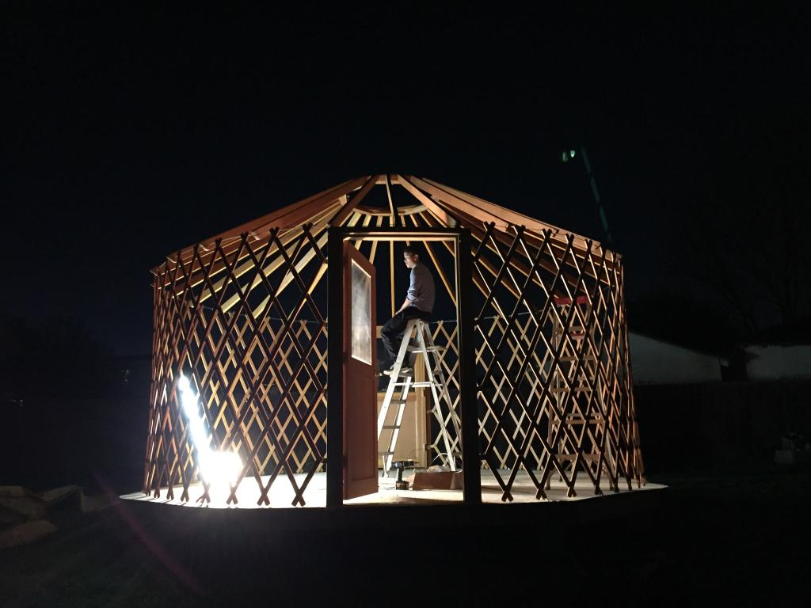
Product box: Yurt-O-Happiness
“Learn, engage, train your mind!”
-Build consistency with your practice
-Engage, learn from other like-minded people
-Setup and join a session at your convenience
Notes:
If you could walk into a store, and buy the shrink wrapped version of your software, what the design of the box look like and what would it say?
Point here is to get your team looking at your project through the eyes of your end customer.

Slide 5
The NOT list
IN | OUT
google hangout API | Ionic
Timer/alarm for meditation session
Time stamp for journal
UNRESOLVED
Having an Agenda for session
Expanding the journal
Ability to add friends
Notes:
List all the big ticket items you are (and are NOT) going to deliver within the scope of this project.
Before starting your project move all the UNRESOLVED ones to either IN or OUT.

Slide 6



Your project community
GA Community
Mr. Google
Max
Friends who meditate
Everyone else !
... Yes it’s bigger than I think!
Notes:
List everyone you are going to have to interact with at some point during the course of your project.
Goal is to start building relationships with these people and let them know we are coming down the tracks (before we actually get there).

Slide 7



Technical solution
Technologies:
Ruby on rails
D3/CSS
Heroku
Github
Danger!
Out of scope
Notes:
This is about letting people know how we plan on building this thing.
If there are any tools or libraries assumptions you are making list them here.
Also if there are areas of the application architecture that are risky highlight those too.

Slide 8

What keeps us up at night
Not getting google hangout api to work
Time constraint
Testing
Notes:
This is your chance to call out any craziness you’ve heard while building the deck, and having a frank conversation with your sponsors and your team about how you are going to handle it.
This is perhaps on of the most powerful slides in the deck – it’s your chance to ask for whatever you need to be successful and the consequences if you don’t get it.
Use it!

Slide 9

How big is this thing?
Ship it!
Construction
UAT
Training
~2weeks
1 day
1 hour
This is a guess. Not a commitment.
Notes:
Give your sponsors some idea of how big this thing is (1, 3, or 6 monther).
Before you can complete this slide you and the team should create and estimate a high-level story list for the project.
This isn’t a commitment (too many unknowns). It’s just a really rough guess. Don’t treat it as anything else.

Slide 10
Trade-off sliders
 | The classic four
 | Feature completeness (scope)
 | Stay within budget (budget)
 | Deliver project on time (time)
 | High quality, low defects (quality)
ON
OFF
ON
OFF
ON
OFF
ON
OFF
 | Other important things
 | Ease of use
 | Don’t make me think!
 | Detailed audits (log everything)
 | Have Fun!
ON
OFF
ON
OFF
ON
OFF
ON
OFF
Notes:
When push comes to shove, something has to give. Here we want to be clear on what that is.
On agile projects we flex on scope. But there could be others factors at play here so get ready to listen as you customer tells you which forces can bend (scope) and which are written in stone (usually budget).
Slider rules:
1. No two sliders can occupy the same level.
2. List other important project factors down below.

Slide 11
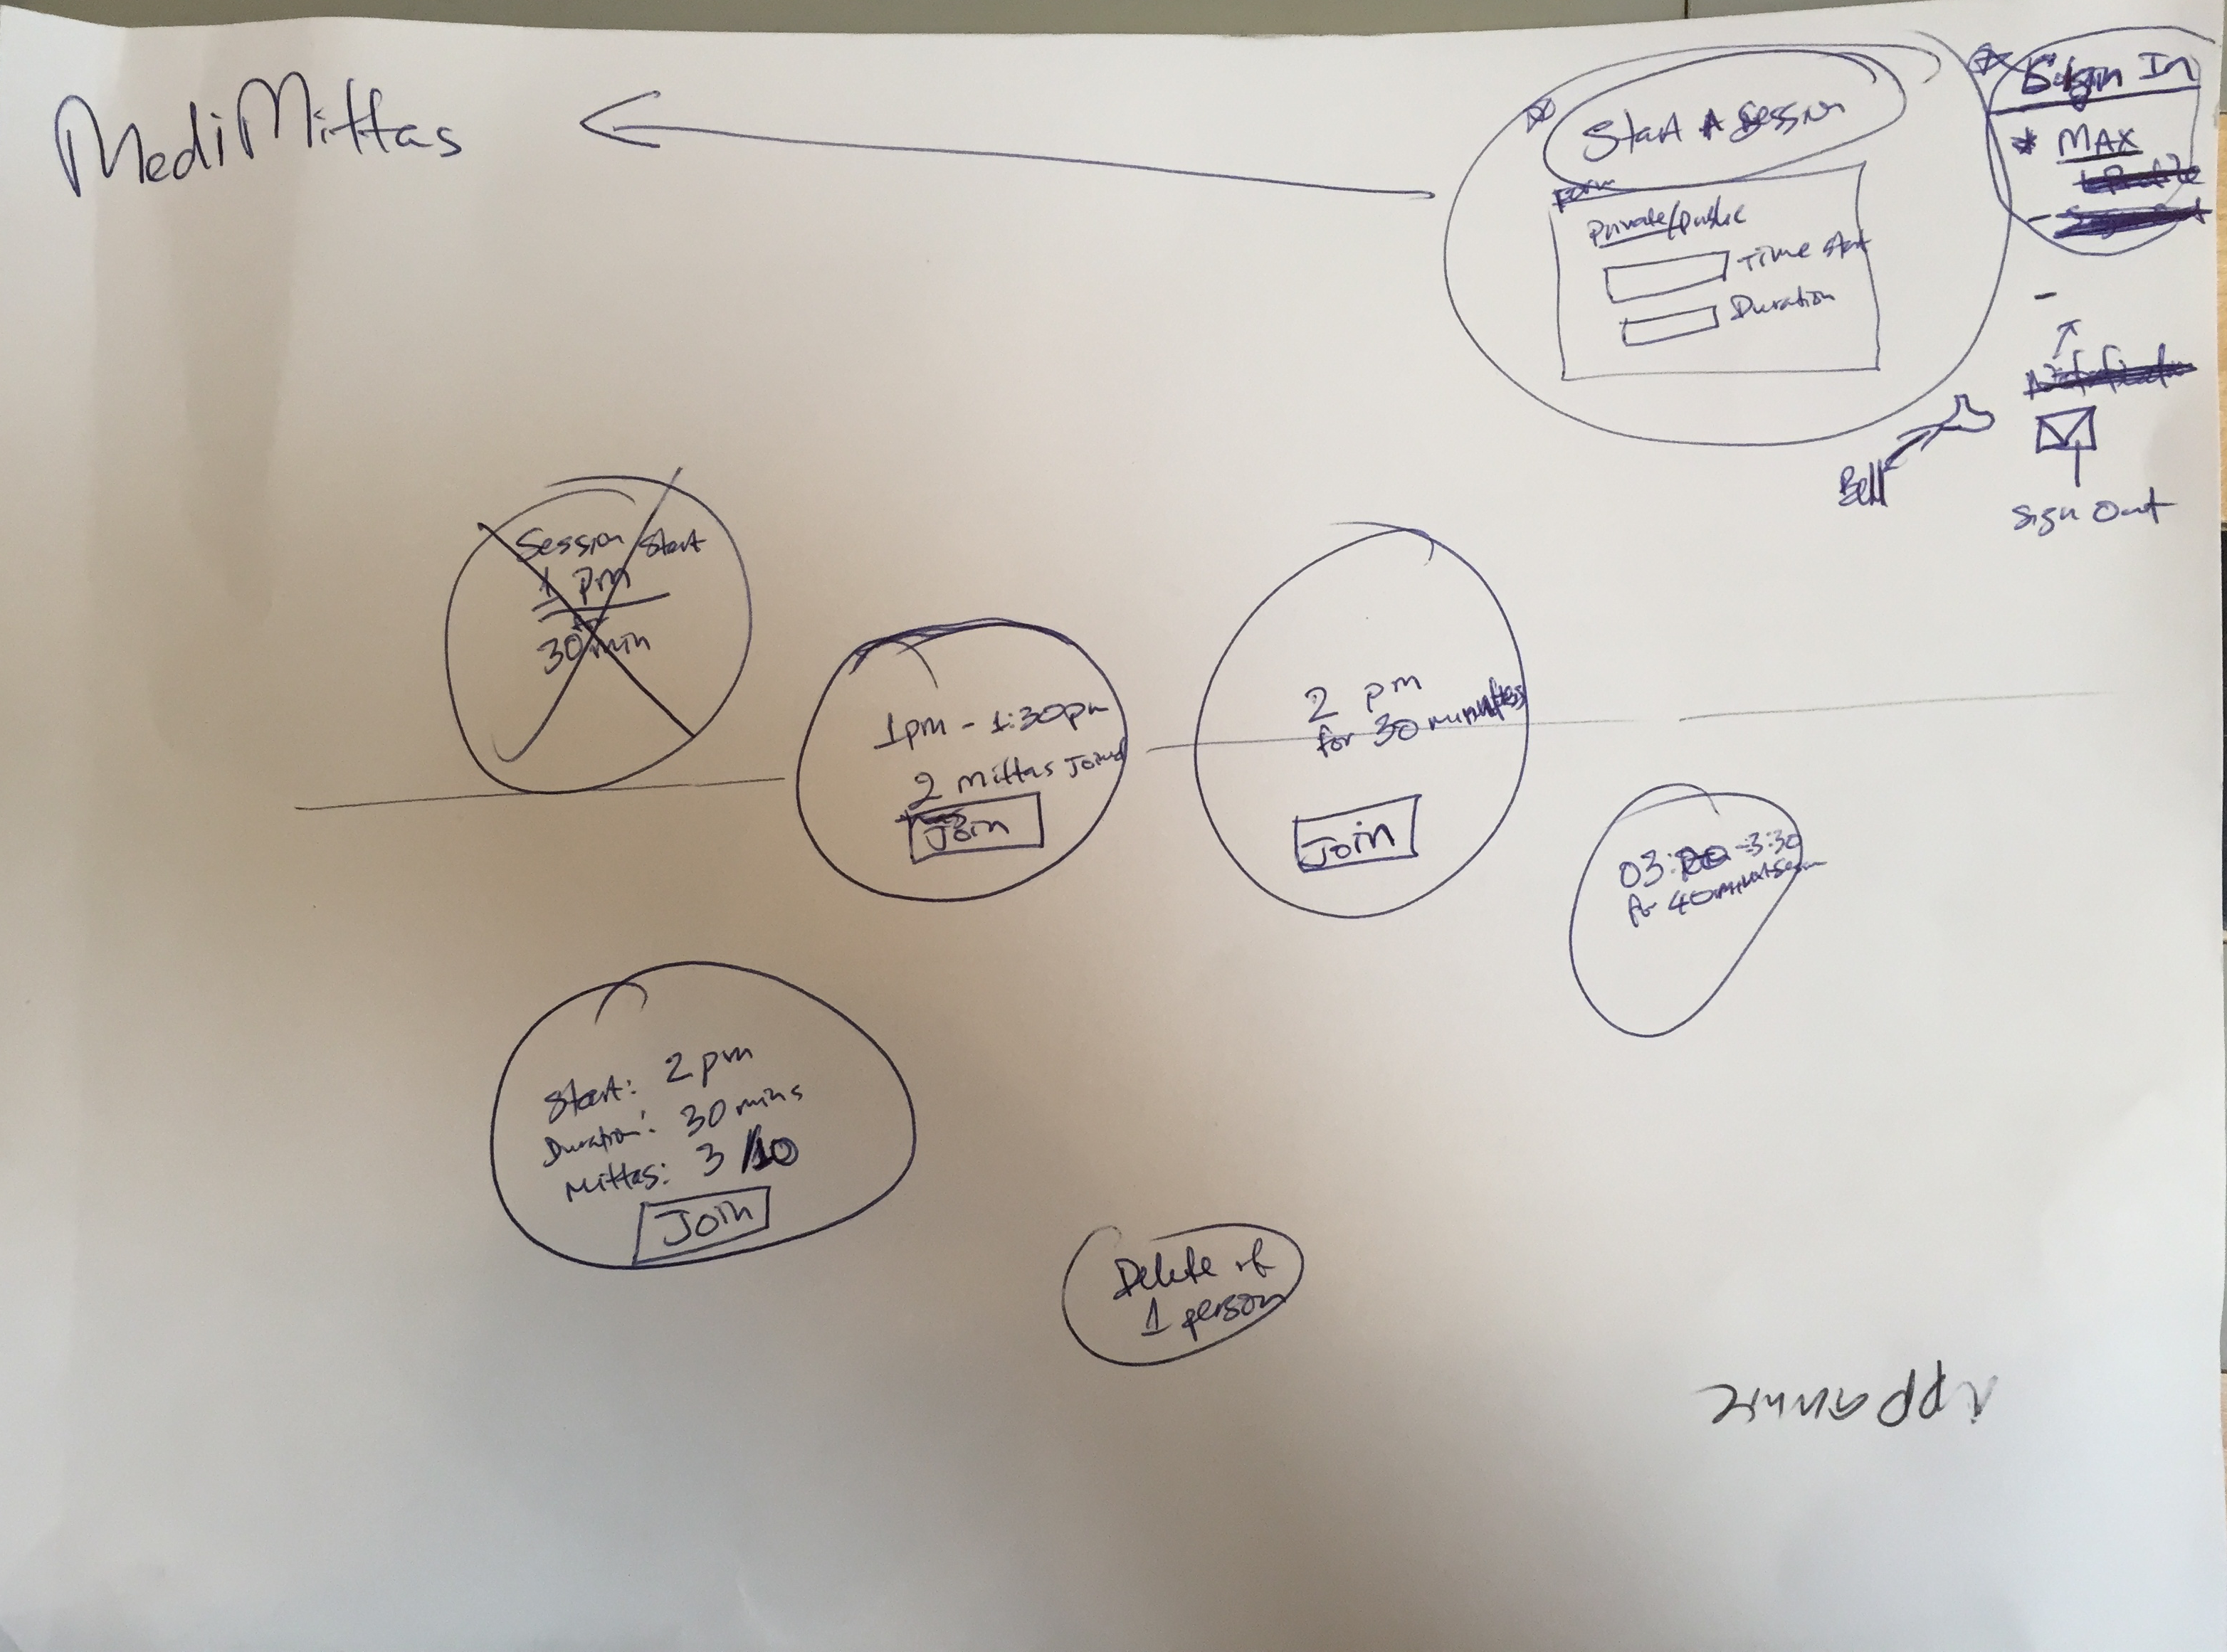

Slide 12
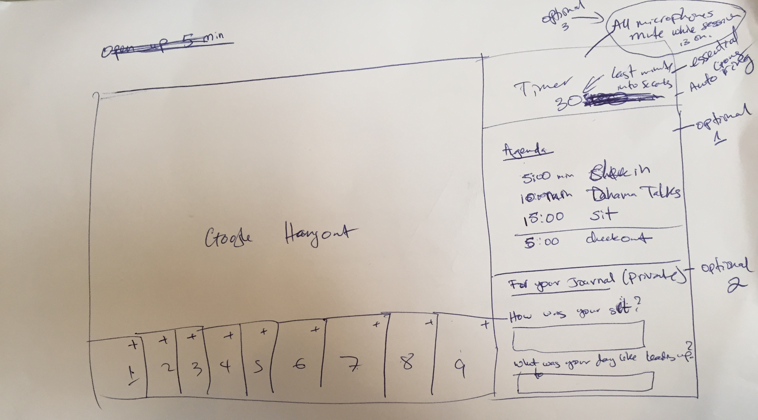

Slide 13
